Slide 1
Customer Segmentation
Group-2

Slide 2
Project Members:
Bhagyashree Ambade
M. Sakthi
Sagar. C
Aswin. P
Shruthi Thandan
Vaishnavi Puram

Slide 3
Business Objective
Customer personality analysis helps a business to modify its product based on its target customers from different types of customer segments.
Finding the potential customers by analyzing the behavior of them is useful to understand the targeted customers.
For example, instead of spending money to market a new product to every customer in the company’s database, a company can analyze which customer segment is most likely to buy the product and then market the product only on that particular segment.
Target
Need to perform clustering to summarize customer segments.

Slide 4
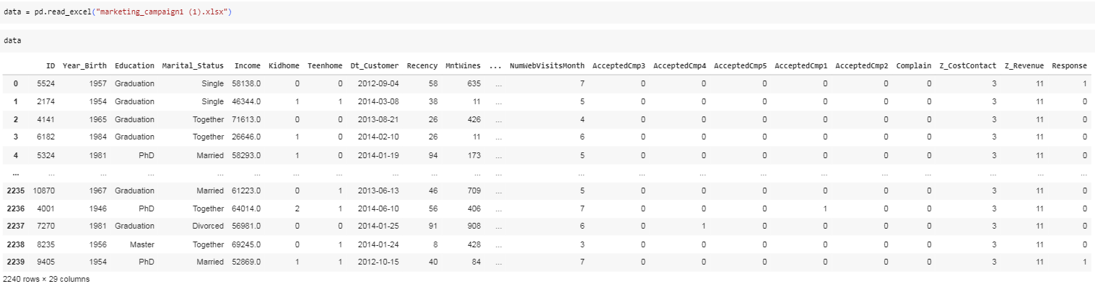
Given Dataset is about marketing_campaign

Slide 5
Dataset Features
People
ID
Year_Birth
Education
Marital_Status
Income
Kidhome
Teenhome
Dt_Customer
Recency
Complain
Products
MntWines
MntFruits
MntMeatProducts
MntFishProducts
MntSweetProducts
MntGoldProds
Promotion
NumDealsPurchases
AcceptedCmp1
AcceptedCmp2
AcceptedCmp3
AcceptedCmp4
AcceptedCmp5
Response
Place
NumWebPurchases
NumCatalogPurchases
NumStorePurchases
NumWebVisitsMonth

Slide 6
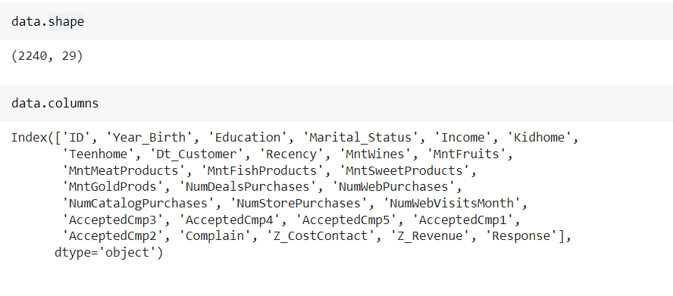
The dataset has 2240 rows and 29 columns.
The columns in the dataset include:
'ID', 'Year_Birth', 'Education', 'Marital_Status', 'Income', 'Kidhome', 'Teenhome', 'Dt_Customer', 'Recency', 'MntWines', 'MntFruits', 'MntMeatProducts', 'MntFishProducts', 'MntSweetProducts', 'MntGoldProds', 'NumDealsPurchases', 'NumWebPurchases', 'NumCatalogPurchases', 'NumStorePurchases', 'NumWebVisitsMonth', 'AcceptedCmp3', 'AcceptedCmp4', 'AcceptedCmp5', 'AcceptedCmp1', 'AcceptedCmp2', 'Complain', 'Z_CostContact', 'Z_Revenue', 'Response'

Slide 7
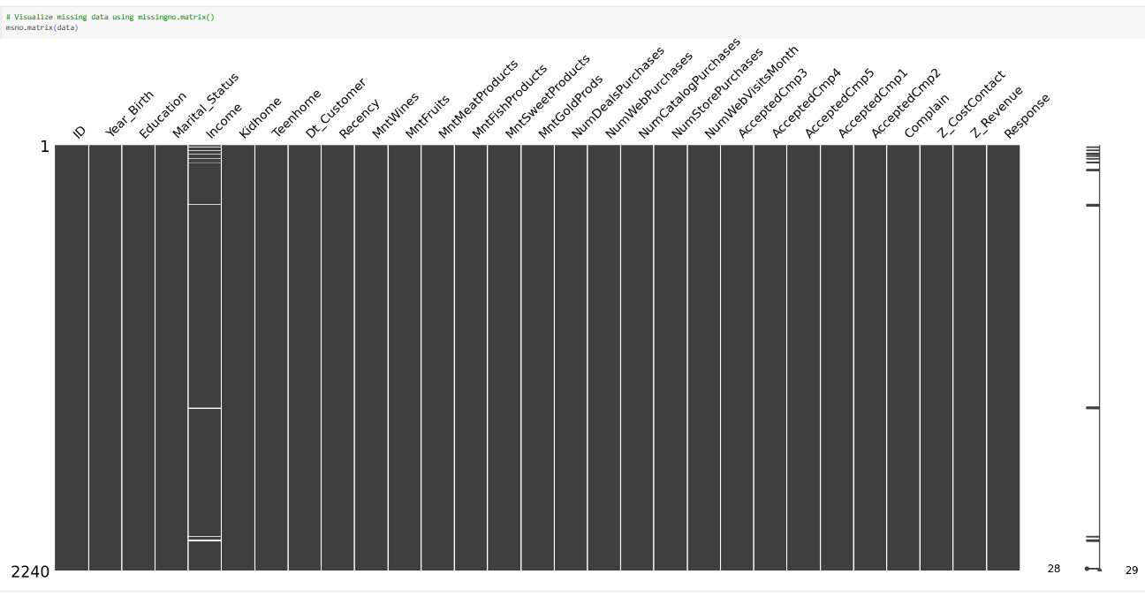
From the output, we can conclude and note that:
There are missing values in income
Dt_Customer that indicates the date a customer joined the database is not parsed as DateTime
There are some categorical features in our data frame; as there are some features in (dtype: object). So we will need to encode them into numeric forms later.

Slide 8
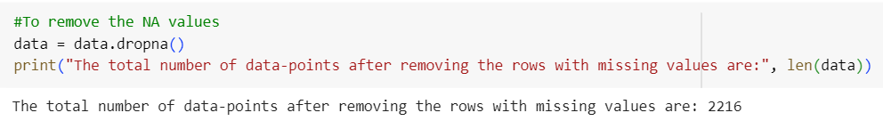
The total number of data-points after removing the rows with missing values are: 2216

Slide 9
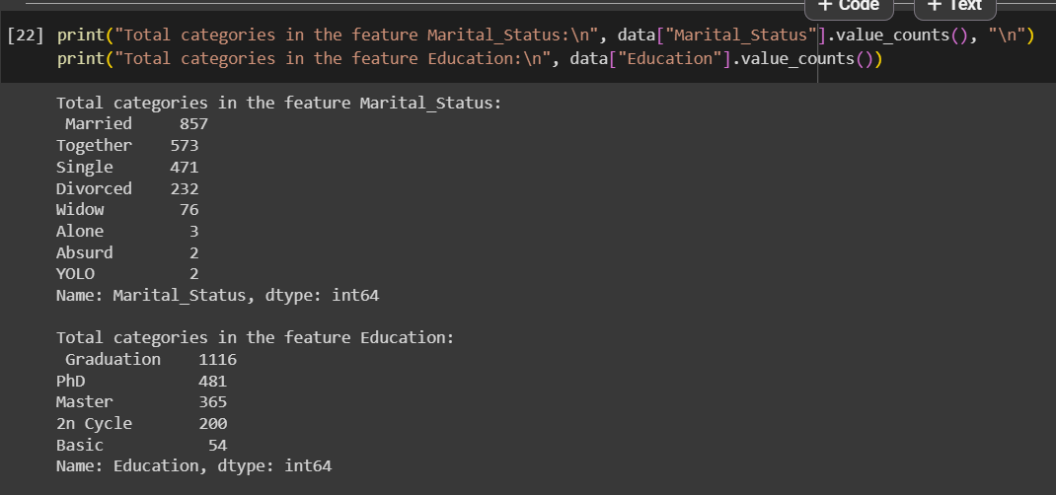
Future Engineering

Slide 10
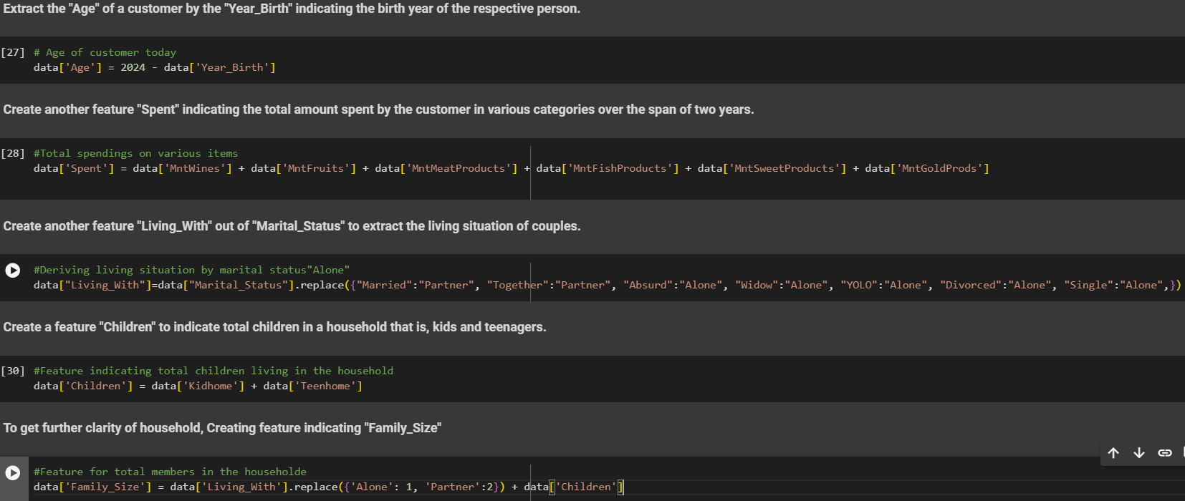

Slide 11
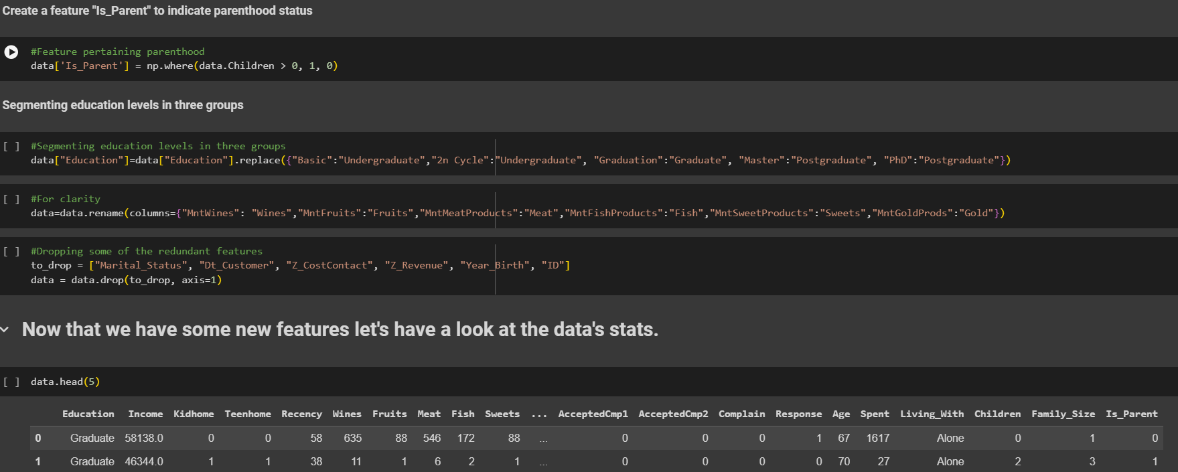

Slide 12
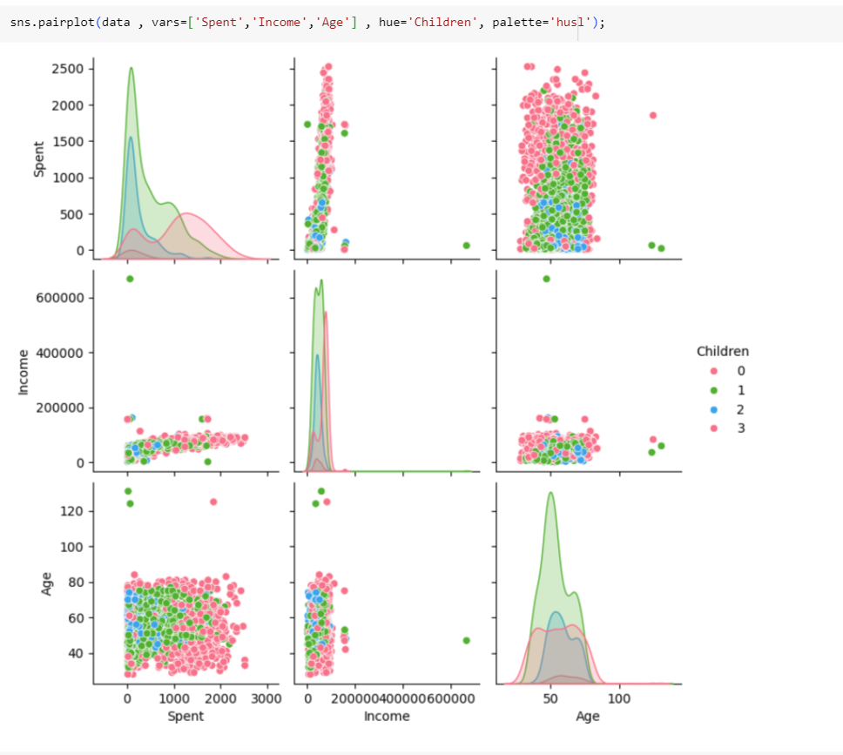
Data Visualization
It generates a pairplot that displays scatter plots and histograms for three variables: ‘Spent’, ‘Income’, and ‘Age’.
The plots are color-coded based on the number of children (0 to 3).
The scatter plots show relationships between pairs of variables, while the histograms display the distribution of each variable.

Slide 13
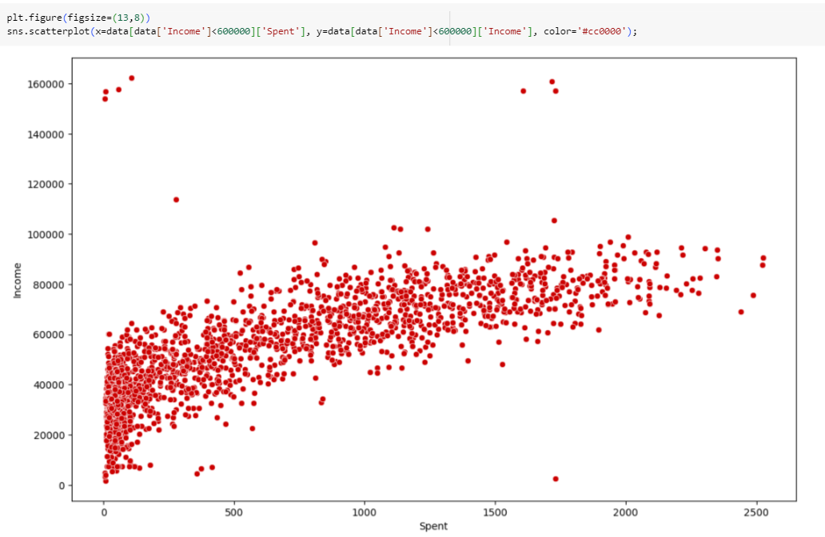
This visualization helps explore the relationship between spending and income
The dense cluster of red dots at the lower end of both axes suggests that many data points have low spending and low income.
As values increase along both axes, the data points become more scattered.
This distribution provides insights into how spending behavior relates to income.

Slide 14
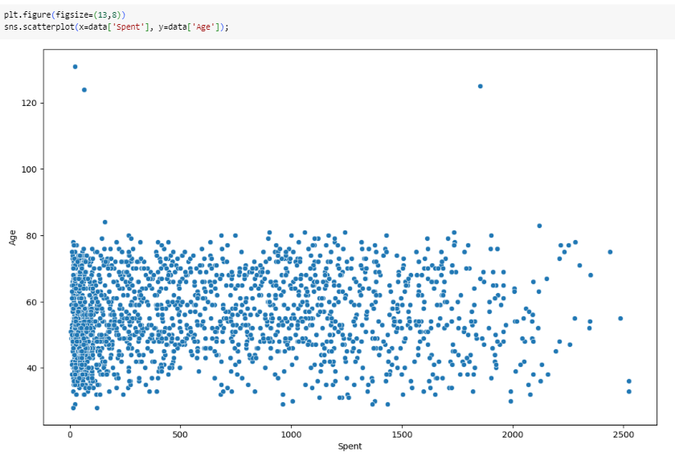
This visualization helps explore how spending behavior relates to age within the dataset.
The dense cluster of blue dots at the lower end of both axes suggests that many data points have low spending and are associated with individuals aged around 60 to 80.
As values increase along the x-axis (amount spent), data points become more scattered.
There’s an outlier data point where the age is above 120, which could potentially be an error or an extreme case.

Slide 15
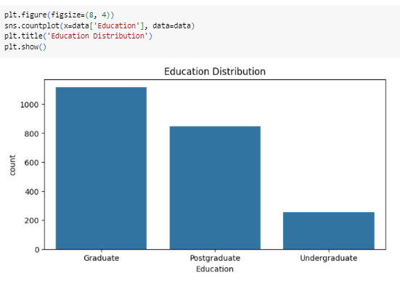
This visualization provides insights into the educational background of the dataset.
The bars show how many people belong to each education level.
The Graduate category has the highest count, reaching up to approximately 1000 individuals.
The Postgraduate category has a count slightly above 600 individuals.
The Undergraduate category has the lowest count, with just over 200 individuals.

Slide 16
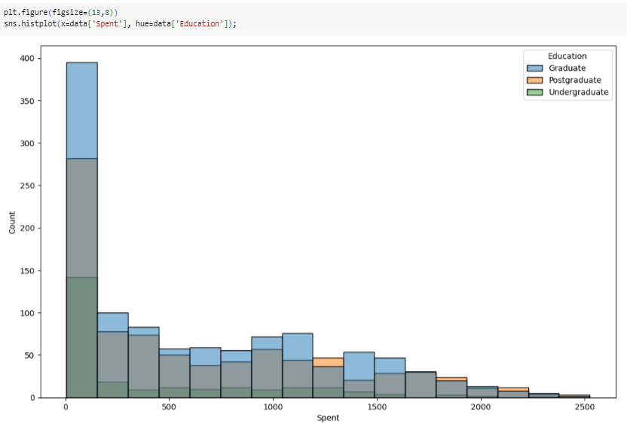
This visualization helps explore how spending behavior varies across different education levels within the dataset
A large green bar indicates that over 350 undergraduates have spent less than 500 units.
Graduates and postgraduates have relatively lower counts in each spending category.
As the amount spent increases, the count of all educational categories decreases.

Slide 17
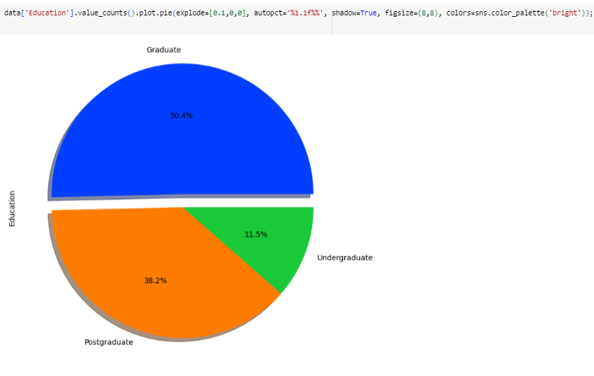
The image shows a colorful pie chart with three distinct segments.
Each segment represents a different level of education: Graduate, Postgraduate, and Undergraduate.
The Graduate segment is blue and occupies the largest portion of the pie at 50.4%.
The Postgraduate segment is orange and accounts for 38.2% of the pie.
The Undergraduate segment is green and makes up 11.5% of the pie.

Slide 18
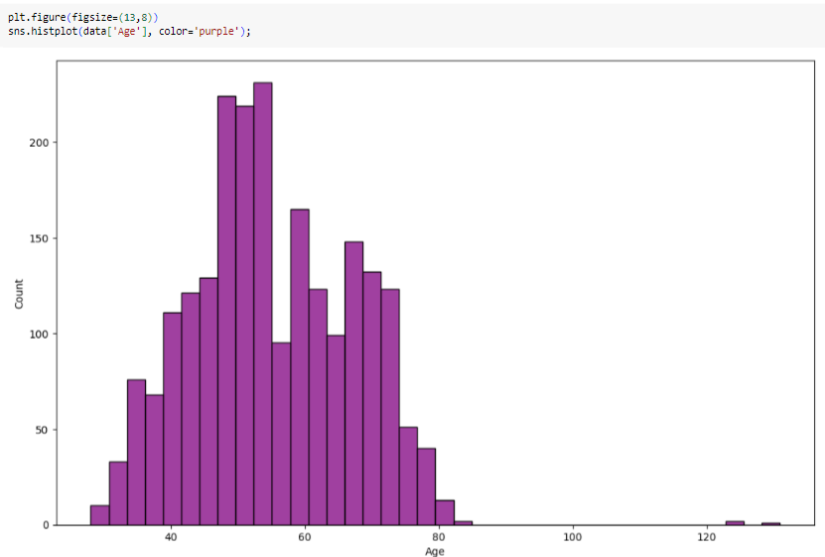
Outlier Detection
This histogram helps us explore the age distribution and identify any potential outliers.
The histogram reveals that there is a prominent peak around ages 50–60. This suggests that this age group has the highest frequency in the dataset.
As we move away from this central peak, the count of occurrences decreases.
There’s an outlier data point where the age is above 120.

Slide 19
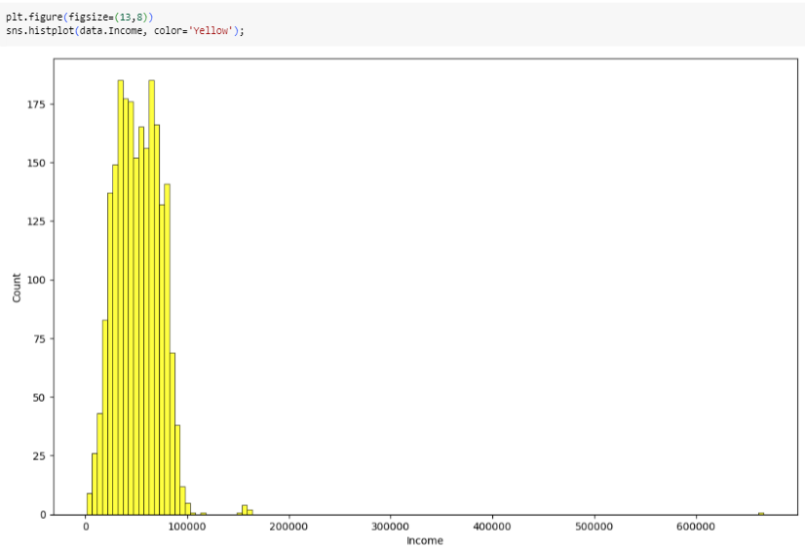
This histogram helps us explore the income distribution and identify any potential outliers. If you notice data points far away from the central peak, those could be outliers.
The prominent peak around income levels of 0–200,000 suggests that most data points fall within this range.
Outliers may appear as data points that significantly deviate from this central peak.
For example, if there’s an individual with an income much higher than the majority, it could be considered an outlier.

Slide 20
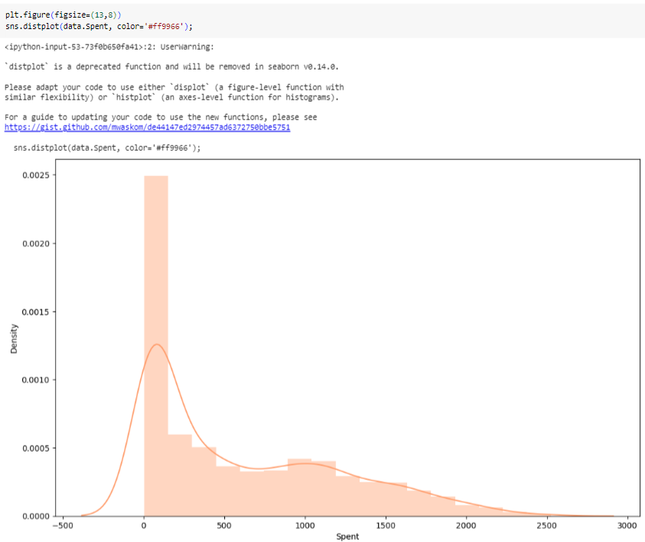
This density plot helps us explore the distribution of expenditure data and identify where data points are concentrated.
The plot shows a peak in density around the 0 mark on the x-axis, indicating that many data points cluster around this value.
There is another smaller peak around 1000.
These peaks represent regions where data points are concentrated.
In the context of this density plot:
If you notice data points far away from the central peaks, those could be outliers.

Slide 21
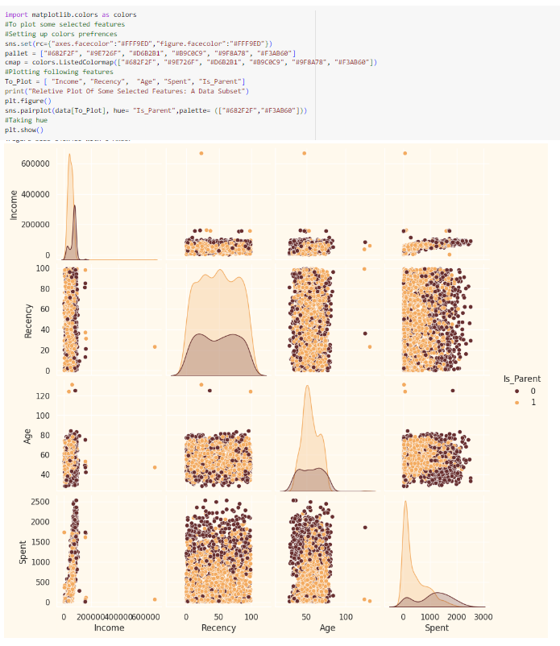
The plot includes four selected features: Income, Recency, Age, and Spent.
Each scatter plot shows the relationship between two features.
Data points are colored differently based on whether the individual is a parent (Is.Parent = 1) or not (Is.Parent = 0).
Outliers can be observed as points that significantly deviate from the main cluster of data points.
Notable observations:
In the ‘Income’ histogram, there are a few bars extending far beyond the main concentration of data, indicating high-income outliers.
In the ‘Spent’ scatter plot, some individuals have exceptionally high amounts spent, which are outliers.

Slide 22
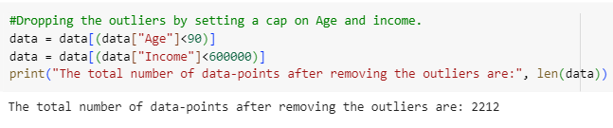
The total number of data-points after removing the outliers are: 2212

Slide 23
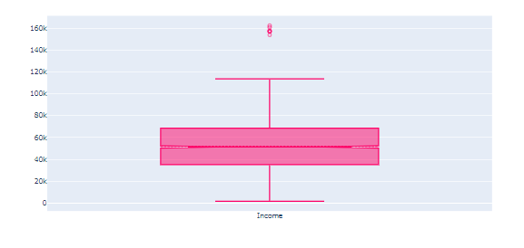
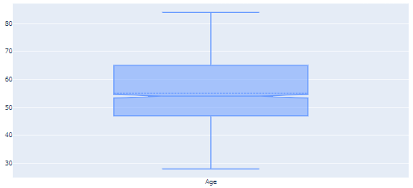
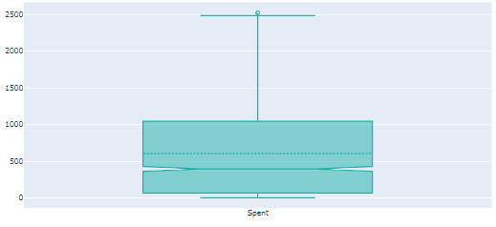
Another way of visualizing outliers is using boxplots and whiskers, which provides the quantiles (box) and inter-quantile range (whiskers), with the outliers sitting outside the error bars (whiskers).
All the dots in the plot below are outliers according to the quantiles + 1.5 IQR rule
The pink box represents the interquartile range (IQR), which contains 50% of the data.
The median income (Q2) is marked by a horizontal line inside the box.
The lower whisker starts at around 40k, and the upper whisker extends up to around 110k.
The outlier at approximately 150k lies outside the whiskers.
The box represents the interquartile range (IQR), spanning from Q1 to Q3.
The median age (Q2) is marked by a horizontal line inside the box.
The lower whisker starts at around age 30, and the upper whisker extends up to around age 80.
The light green box represents the interquartile range (IQR), spanning from Q1 to Q3.
The median spent value (Q2) is marked by a horizontal line inside the box.
The lower whisker starts at around 500, and the upper whisker extends up to around 1500.
The outlier near 2500 lies outside the whiskers

Slide 24
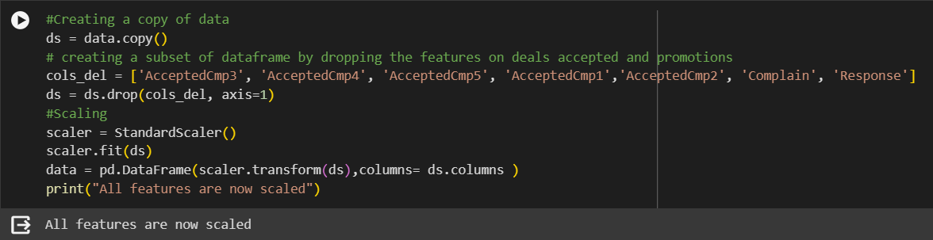
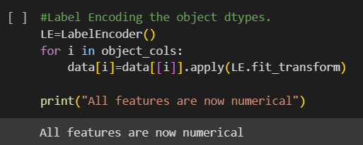
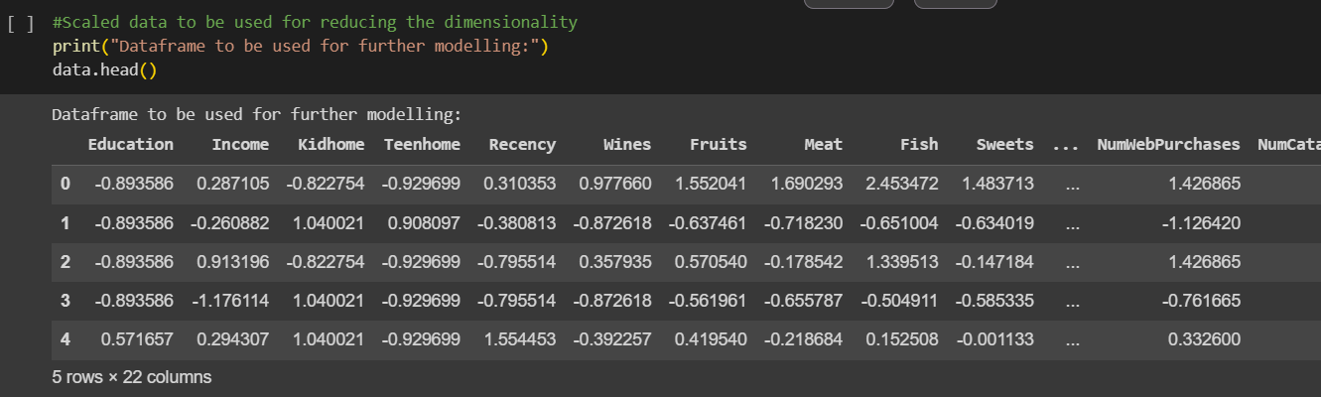
Data Preprocessing
The following steps are applied to preprocess the data:
Label encoding the categorical features
Scaling the features using the standard scaler
Creating a subset dataframe for dimensionality reduction

Slide 25
Dimensionality Reduction
In this problem many of these features are correlated, and hence redundant. This is why I will be performing dimensionality reduction on the selected features before putting them through a classifier.
Dimensionality reduction is the process of reducing the number of random variables under consideration, by obtaining a set of principal variables.
Principal component analysis (PCA) is a technique for reducing the dimensionality of such datasets, increasing interpretability but at the same time minimizing information loss.
Principal component analysis (PCA) is a technique for reducing the dimensionality of such datasets, increasing interpretability but at the same time minimizing information loss.
Steps in this section:
Dimensionality reduction with PCA Plotting the reduced dataframe Dimensionality reduction with PCA
For this project, I will be reducing the dimensions to 3.

Slide 26
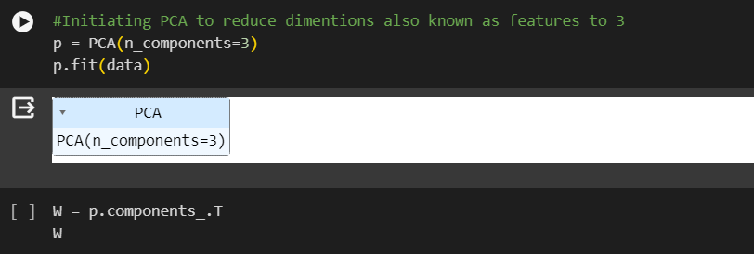
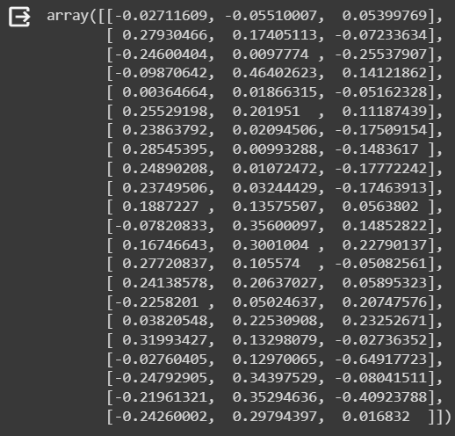
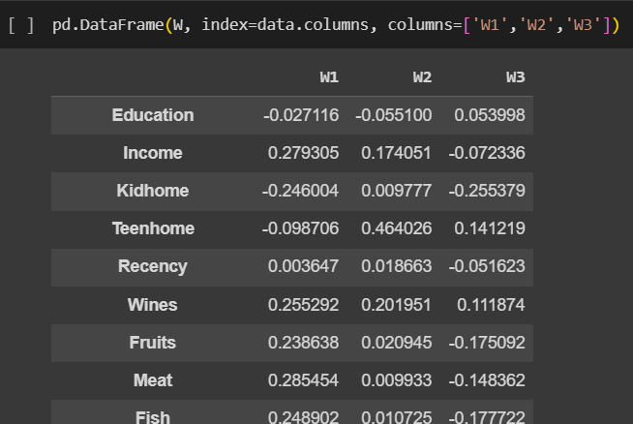

Slide 27

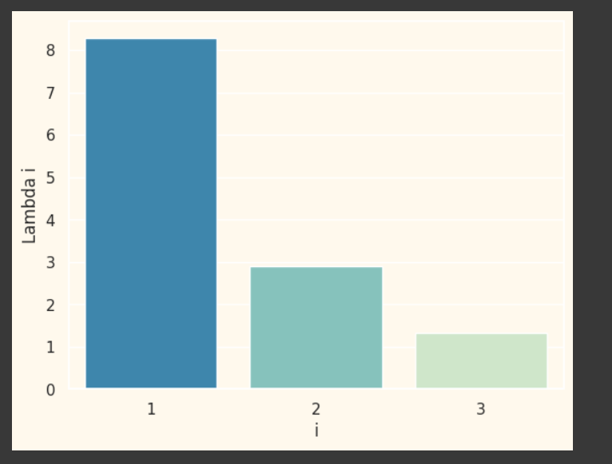
Each bar represents the explained variance of a principal component, with the x-axis indicating the index of the principal component and the y-axis indicating the amount of variance explained.

Slide 28
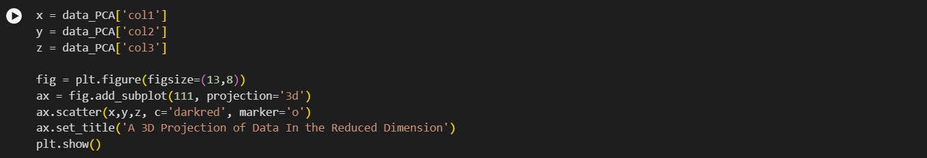
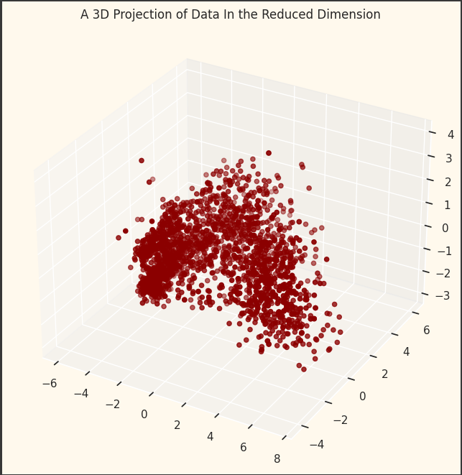
This code creates a 3D scatter plot of the data in the reduced dimension space obtained through PCA transformation

Slide 29
Clustering

Slide 30
Clustering
Now that I have reduced the attributes to three dimensions, I will be performing clustering via Agglomerative clustering. Agglomerative clustering is a hierarchical clustering method. It involves merging examples until the desired number of clusters is achieved.
Steps involved in the Clustering
Elbow Method to determine the number of clusters to be formed
Clustering via Agglomerative Clustering
Examining the clusters formed via scatter plot

Slide 31
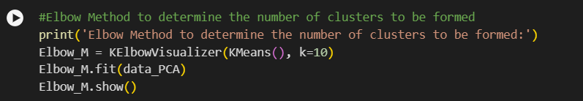
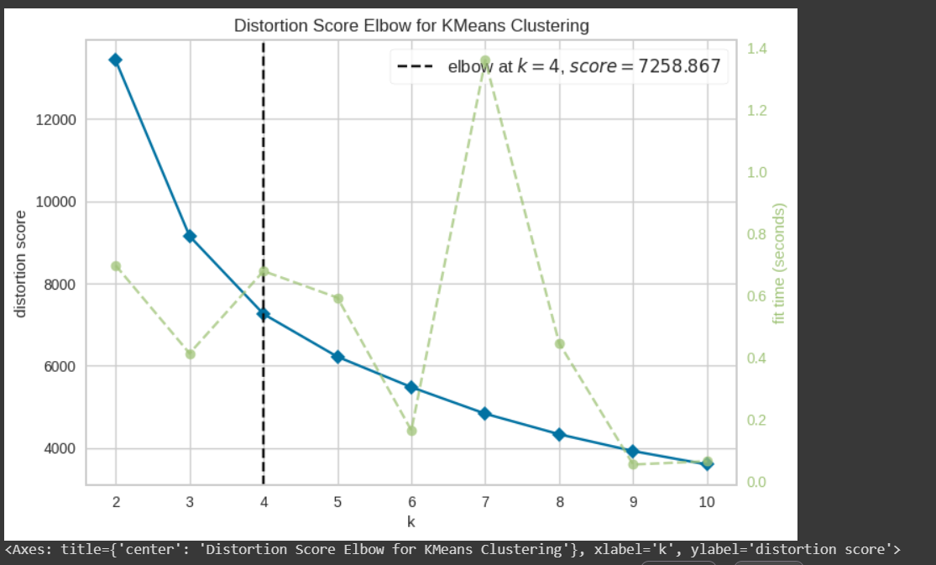
Based on the plot generated by Elbow_M.show(), you observe that four clusters would be the optimal choice for clustering this data, as it represents the point where adding more clusters doesn't lead to a significant reduction in within-cluster sum of squares.

Slide 32
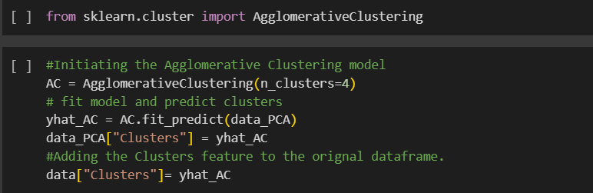
Next, we will be fitting the Agglomerative Clustering Model to get the final clusters.
Agglomerative clustering is a hierarchical clustering technique where clusters are iteratively merged based on their similarity. We specify the number of clusters we want to form using the n_clusters parameter, which is set to 4 in this case.
This code segment fits the Agglomerative Clustering model to the transformed data obtained from PCA and assigns cluster labels to each data point. These cluster labels are then added to both the transformed data (data_PCA) and the original dataset (data). This allows for further analysis and interpretation of the clustering results.

Slide 33
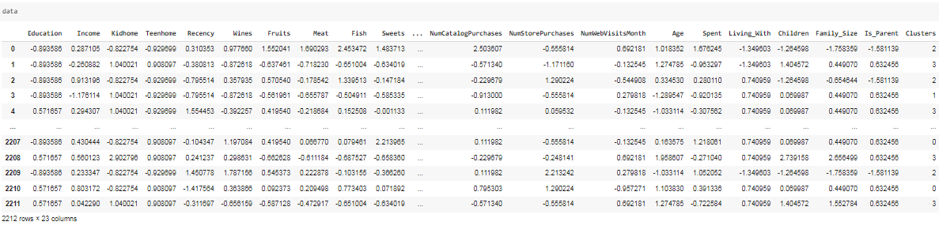
This is dataset after adding cluster label

Slide 34
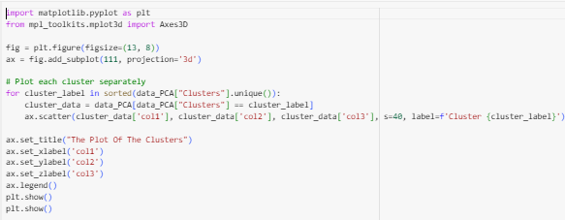
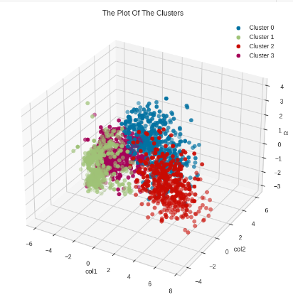
The 3D scatter plot shows the data points distributed in the 3D space based on their coordinates along the principal components, with each cluster represented by a different color.
This visualization helps to understand the distribution of data points and the separation between clusters in the reduced dimension space.

Slide 35
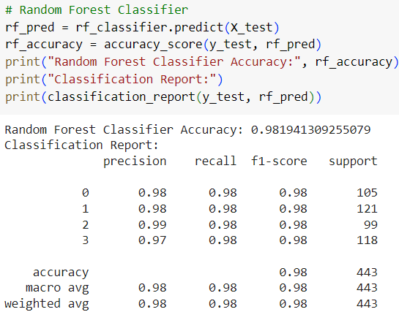
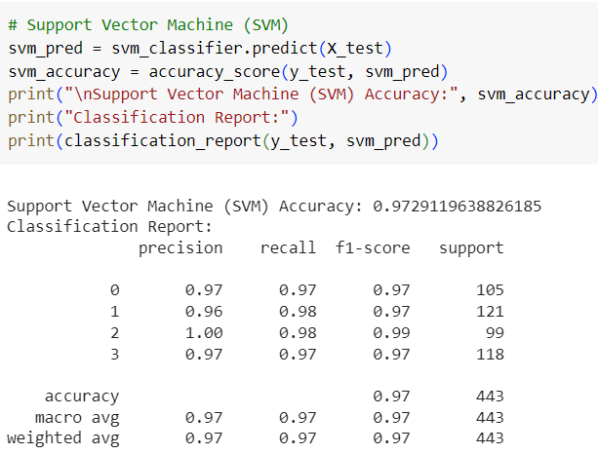
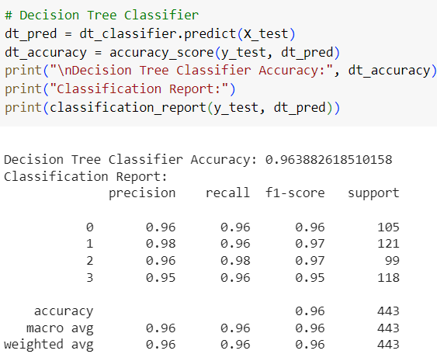
Model Evaluation
We present the evaluation of various classification models applied to the dataset. We compare the performance of Random Forest, Support Vector Machine (SVM), and Decision Tree classifiers.
After thorough evaluation, it was evident that the Random Forest Classifier outperformed the other models. It achieved the highest accuracy and demonstrated robust performance across precision, recall, and F1-scores for each cluster label.

Slide 36
Deployment

Slide 37
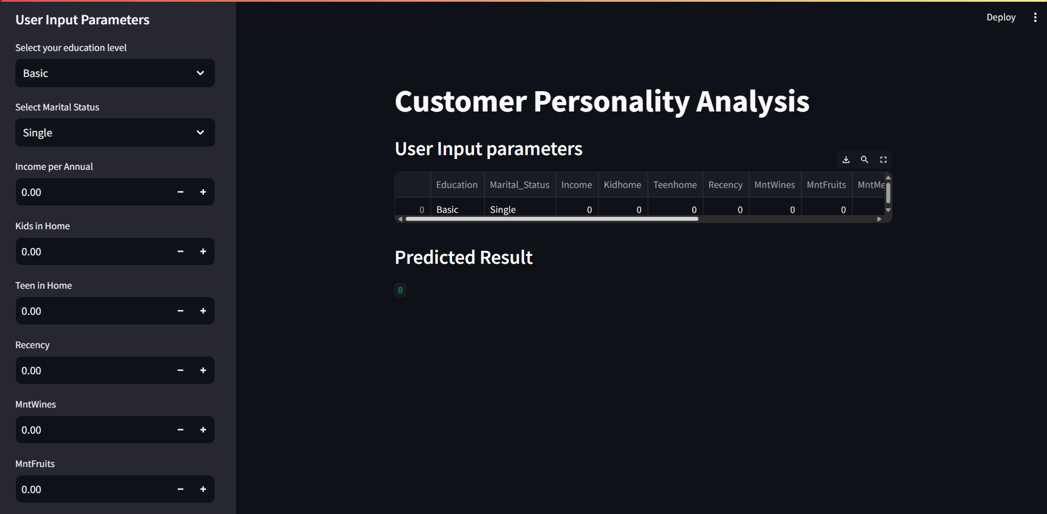

Slide 38
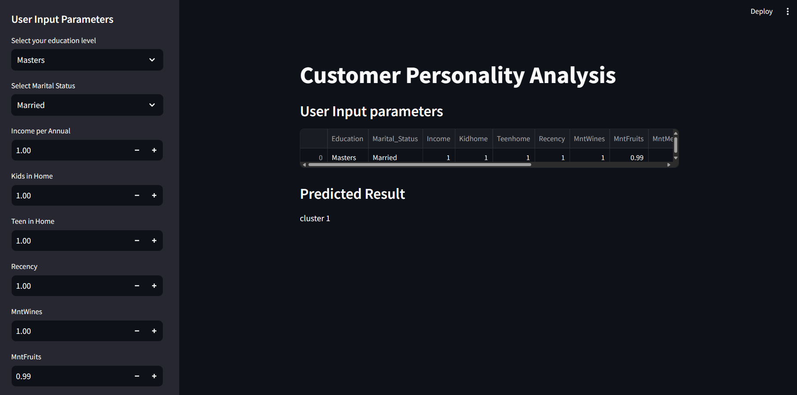

Slide 39
